Slide 1
Clean code
György Aszalos, Krisztián Németh
19.06.2023
Notes:
K

Slide 2
Clean code
names
functions
Function structures
form
SOLID
Architecture use cases and high level design
Notes:
K

Slide 3
Clean code
What is Clean Code?
"I like my code to be elegant and efficient...Clean code does one thing well“ - Bjarne Stroustrup, inventor of C++ and author of The C++ Programming Language
"Clean code is simple and direct. Clean code reads like well-written prose“ - Grady Booch, author of Object Oriented Analysis and Design with Applications
"Clean code always looks like it was written by someone who cares.“ - Michael Feathers, author of Working Effectively with Legacy Code
“You know you are working on clean code when each routine you read turns out to be pretty much what you expected." - Ward Cunningham, inventor of Wiki, inventor of Fit
Why should have clean code?
Bad code will slow you down
It was the bad code that brought the company down.
The Total Cost of Owning a Mess
The boy scout rule
"leave the world better than you founded“
Book:
Clean Code - A Handbook of Agile Software Craftsmanship
Robert C. Martin
Notes:
GY
IMPORTANT!
Not every principle herein has to be strictly followed, and even fewer will be universally agreed upon.
These are guidelines and nothing more, but they are ones codified over many years of collective experience by the authors of Clean Code.

Slide 4
Clean code
Code rot
Rigidity – modification in one place force you to modify in many other
Fragility – break in many places when you touch only one
Inseparability – modules can’t be separated and reuse for other purposes
Opacity
measurement of code quality: WTFs/minute
not communicate the authors intent, hard to read, hard to understand, hard to change
Going fast - if you want to go fast you have to stay clean, the only way to go fast is to go well
Writing clean code is what you must do in order to call yourself a professional.
There is no reasonable excuse for doing anything less than your best.
Notes:
GY
Have you ever been significantly impeded by bad code?
We slog through a morass of tangled brambles and hidden pitfalls.
We struggle to find our way, hoping for some hint, some clue, of what is going on;
but all we see is more and more senseless code.
Were you trying to go fast? Were you in a rush? Probably so.
Perhaps you felt that you didn’t have time to do a good job;
that your boss would be angry with you if you took the time to clean up your code.
We’ve all said we’d go back and clean it up later.
Of course, in those days we didn’t know LeBlanc’s law: Later equals never.
The productivity trap
Code fast at the begining, feature after feature
Later because of the messy code things got slower
Tried fixes:
- more pressure on software developer
- more people to the team
- major redesign (developer) => race between 2 teams
- tiger team: develop new design => requirements ? incomplete, last minute fixes, midnight modifications => was the old code
- rest: bug fixes - new features on old

Slide 5
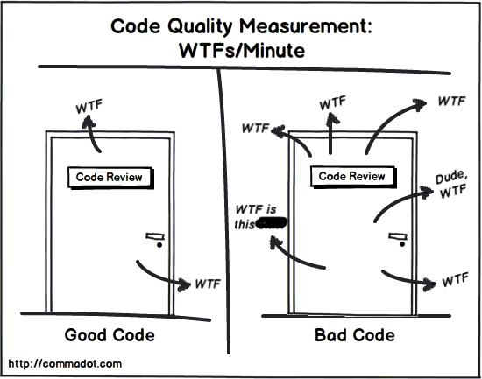
Clean code
Code rot
Rigidity – modification in one place force you to modify in many other
Fragility – break in many places when you touch only one
Inseparability – modules can’t be separated and reuse for other purposes
Opacity
measurement of code quality: WTFs/minute
not communicate the authors intent, hard to read, hard to understand, hard to change
Going fast - if you want to go fast you have to stay clean, the only way to go fast is to go well
Writing clean code is what you must do in order to call yourself a professional.
There is no reasonable excuse for doing anything less than your best.
Notes:
GY
Have you ever been significantly impeded by bad code?
We slog through a morass of tangled brambles and hidden pitfalls.
We struggle to find our way, hoping for some hint, some clue, of what is going on;
but all we see is more and more senseless code.
Were you trying to go fast? Were you in a rush? Probably so.
Perhaps you felt that you didn’t have time to do a good job;
that your boss would be angry with you if you took the time to clean up your code.
We’ve all said we’d go back and clean it up later.
Of course, in those days we didn’t know LeBlanc’s law: Later equals never.
The productivity trap
Code fast at the begining, feature after feature
Later because of the messy code things got slower
Tried fixes:
- more pressure on software developer
- more people to the team
- major redesign (developer) => race between 2 teams
- tiger team: develop new design => requirements ? incomplete, last minute fixes, midnight modifications => was the old code
- rest: bug fixes - new features on old

Slide 6
Names
Names are for communicating intent
Communicating intent is even more important than making sure the code works
The true cost of software is in the maintenance
Whenever you have to read the code in order to understand the name, the name pretty much failed to communicate
Avoid disinformation => worst sin a programmers can commit
Name should say what it means and mean what it said
Use pronounceable names
Avoid encodings – Hungarian annotation
Replace magic numbers with named constants
"Any fool can write code a computer can understand,
but it takes a good programmer to write code a human can understand."
Notes:
GY
- Pronounceable names: “CDate”, “UUser” vs “CreationDate”, “UpdateUser”
- Hungarian annotation: “StrName”/”NameString” vs “Name”

Slide 7
Names
Names are for communicating intent
Communicating intent is even more important than making sure the code works
The true cost of software is in the maintenance
Whenever you have to read the code in order to understand the name, the name pretty much failed to communicate
Avoid disinformation => worst sin a programmers can commit
Name should say what it means and mean what it said
Use pronounceable names
Avoid encodings – Hungarian annotation
Replace magic numbers with named constants
int d; // elapsed time in days
"Any fool can write code a computer can understand,
but it takes a good programmer to write code a human can understand."
Notes:
GY
- Pronounceable names: “CDate”, “UUser” vs “CreationDate”, “UpdateUser”
- Hungarian annotation: “StrName”/”NameString” vs “Name”

Slide 8

Names
Names are for communicating intent
Communicating intent is even more important than making sure the code works
The true cost of software is in the maintenance
Whenever you have to read the code in order to understand the name, the name pretty much failed to communicate
Avoid disinformation => worst sin a programmers can commit
Name should say what it means and mean what it said
Use pronounceable names
Avoid encodings – Hungarian annotation
Replace magic numbers with named constants
int d; // elapsed time in days
int elapsedTimeInDays;
"Any fool can write code a computer can understand,
but it takes a good programmer to write code a human can understand."
Notes:
GY
- Pronounceable names: “CDate”, “UUser” vs “CreationDate”, “UpdateUser”
- Hungarian annotation: “StrName”/”NameString” vs “Name”

Slide 9
Names
Parts of speech
Noun - variables, class
Verbs – methods: getPrice(), postPayment()
Predicate – methods that returns boolean: isPostable()
Predicate – boolean: isEmpty
Adjectives – enums are often adjectives
The scope length rule - scope length vs. name length
Variables: proportional
Functions, classes: inverse proportional
Derived classes (exception): adjective in their names
Notes:
GY

Slide 10
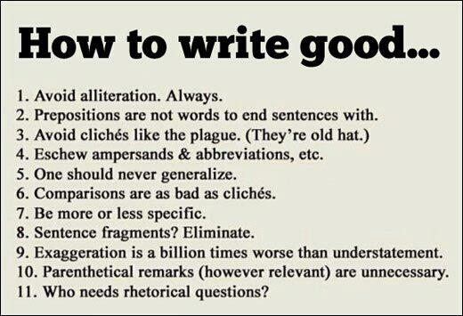

Slide 11
Functions
What we do
A function should do one thing
One thing - do it well and do it only
Size - How big? 20 - 30 lines?
4 lines, maybe 5,6 but 10 is too big
Coding time - long functions will eat a lot of time for team members, and even for you
Extract till you drop
Keep your room clean! It's hard to be in a team where you been surrounded by mess all the time.
Efficiency - readability first
Large functions - that's where your classes tend to hide!
Notes:
K
Extract predicates of if while in functions.
Large code - why we like them? Because we are familiar with that; recognize as landmarks, but not good for beginners as they gets lost.
With small and well named functions, sign posts, save times, even beginners can find their way and can be productive in less time.
Sign posts

Slide 12
Functions
public List<int[]> getThem(List<int[]> theList)
{
List<int[]> list1 = new List<int[]>();
for (int i = 0; i < theList.Count; i++)
{
int[] x = theList[i];
if (x[0] == 4)
{
list1.Add(x);
}
}
return list1;
}
Notes:
K
Gets items from a list of arrays… Which items? Why?

Slide 13
Functions
public List<int[]> getThem(List<int[]> theList)
{
List<int[]> list1 = new List<int[]>();
for (int i = 0; i < theList.Count; i++)
{
int[] x = theList[i];
if (x[0] == 4)
{
list1.Add(x);
}
}
return list1;
}
public List<Cell> getFlaggedCells(List<Cell> gameBoard)
{
List<Cell> flaggedCells = new List<Cell>();
foreach (Cell cell in gameBoard)
{
if (cell.IsFlagged())
{
flaggedCells.Add(cell);
}
}
return flaggedCells;
}
Notes:
K
Ohh, game board… cells… flagged cells…

Slide 14
Function structures
Arguments - fewer is better, 3 arg max
Constructors same rule, prefer to use setter functions
No boolean to pass to a function
Innies not outies
The null defense
The stepdown rule
Switches and cases - missed opportunities to use polymorphism (some says it's not object oriented)
Notes:
GY
No boolean to pass to a function
=> as we declare to the world that the function is doing more than one thing.
instead write 2 function one for the true case and one for the false case.
Innies not outies
- no output argument, use return value
cause double takes, avoid where possible
The null defense -
=> don't pass a nullable argument
make 2 function, one that gets the arguments with value, and one without argument
Defensive programming => hate them, my teammates are so careless, waste of time
means you don't trust your teammates or unit tests
The stepdown rule
- some time ago there was a scissor rule = public top, private bottom
- follow a non optimal convention is better than to confuse everybody by doing something unexpected

Slide 15
Function structures
Functional programming
No assignment statement, no side effects
Side effects - a function modifies an element that lives outside of function
Temporal coupling
Command query separation
Tell don't ask
Structured programming
Algorithms:
sequence
selection
iteration
One entry, one exit
Notes:
GY
Temporal coupling - one call have to be called after another thing
- order of things matter
- there are hidden, why is this order
- passing a block
(public void open(File f, FileCommand c){
f.open();
c.process(f);
f.close();
})
- the goal is not to eliminate side effects, but impose discipline where those side effects are allowed
Command querry separation
- command change the state of the system (setter)
- querie returns (getter)
- function that set state, can throw exceptions, but should not return values
functions that return something should not set states
Tell don't ask
- tell other objects what to do but not to ask object what there state is
- trainwrecks, long chain of querries
- law of Demeter
More precisely, the Law of Demeter says that a method f of a class C should only call
the methods of these:
• C
• An object created by f
• An object passed as an argument to f
• An object held in an instance variable of C
The method should not invoke methods on objects that are returned by any of the
allowed functions.
In other words, talk to friends, not to strangers.
violate example:
final String outputDir = ctxt.getOptions().getScratchDir().getAbsolutePath();

Slide 16
Function structures
Error handling
put error handling first, to not obscure code
create own derived exceptions
exception message, not needed, name well the exception class
null is a value not an exception, a find should return null, not an exception, neither -1 because that is an integer.
Notes:
GY

Slide 17
Form
Comments
comments should be rare
too much, we will ignore them
only for special cases
comments are failure, express yourself by code (naming correctly)
comments are lies, they rot
Notes:
K (break)

Slide 18
Form
Good comments
copyright
informative comments (explains horrible regular expression)
clarification and explanation of intents
warning of consequences
TODO comments
public API documentation
Bad comments
mumbling
redundant explanation, DRY (don't repeat yourself)
mandatory redundancy (stupidity)
journal comments
big banner comments
closing brace comments
attribution comments
HTML in comments
non-local information
commented out code, delete it when you see it
Notes:
K

Slide 19
Form
public int GetHash(string data)
{
// The hash
var hash = 0;
// Length of string
var length = data.Length;
// Loop through every character in data
for (var i = 0; i < length; i++)
{
// Get character code.
var character = data[i];
// Make the hash
hash = ((hash << 5) - hash) + character;
// Convert to 32-bit integer
hash &= hash;
}
return hash;
}
Notes:
K
// good

Slide 20
Form
public int GetHash(string data)
{
// The hash
var hash = 0;
// Length of string
var length = data.Length;
// Loop through every character in data
for (var i = 0; i < length; i++)
{
// Get character code.
var character = data[i];
// Make the hash
hash = ((hash << 5) - hash) + character;
// Convert to 32-bit integer
hash &= hash;
}
return hash;
}
public int GetHash(string data)
{
var hash = 0;
var length = data.Length;
for (var i = 0; i < length; i++)
{
var character = data[i];
hash = ((hash << 5) - hash) + character;
// Convert to 32-bit integer
hash &= hash;
}
return hash;
}
Notes:
K
// good

Slide 21
Form
public int GetHash(string data)
{
var hash = 0;
var length = data.Length;
for (var i = 0; i < length; i++)
{
var character = data[i];
hash = ((hash << 5) - hash) + character;
// Convert to 32-bit integer
hash &= hash;
}
return hash;
}
Notes:
K
Can it be better? Do you understand the hashing logic? Which algorithm is it? Would comments or further refactor help?

Slide 22
Form
public int GetHash(string data)
{
var hash = 0;
var length = data.Length;
for (var i = 0; i < length; i++)
{
var character = data[i];
// use of djb2 algorithm is a good
//compromise of speed and low collision
hash = ((hash << 5) - hash) + character;
public int GetHash(string data)
{
var hash = 0;
var length = data.Length;
for (var i = 0; i < length; i++)
{
var character = data[i];
hash = ((hash << 5) - hash) + character;
// Convert to 32-bit integer
hash &= hash;
}
return hash;
}
hash = ConvertTo32BitInt(hash);
}
return hash;
}
private int ConvertTo32BitInt(int value)
{
return value & value;
}
Notes:
K
// better
If a comment explains WHAT the code is doing, it is probably a useless comment and can be implemented with a well named variable or function.
The comment in the previous code could be replaced with a function named ConvertTo32bitInt so this comment is still useless.
However it would be hard to express by code WHY the developer chose djb2 hash algorithm instead of sha-1 or another hash function.
In that case a comment is acceptable.

Slide 23
Form
Formatting
file length and project size are not corelated
50 - 60 lines, max 500 lines - standard maybe
small is the goal
blank lines - variables grouping, while, for, rule: group related things
Horizontal formatting
line length? - never make your reader to scroll right
we like: 30-40 character
don't like: lines > 80 characters
Indentation
tabs or spaces? use spaces
2,4,8 characters wide? use 2
where you put your braces?
don't care about indentation, but do care that everybody in the team use the exact same style
choose a style and then use it
Notes:
K

Slide 24
Form
Define and maintain a consistent code style in your codebase using:
an .editorconfig file
extensions (i.e StyleCop, CodeMaid, Prettier, Beautify, …)
Notes:
K

Slide 25
Form
[*]
indent_style = space
indent_size = 2
end_of_line = lf
charset = utf-8
trim_trailing_whitespace = true
insert_final_newline = true
# C# files
[*.cs]
indent_size = 4
# New line preferences
csharp_new_line_before_open_brace = all
csharp_new_line_before_else = true
csharp_new_line_before_catch = true
csharp_new_line_before_finally = true
# Code files
[*.{cs,csx,vb,vbx}]
indent_size = 4
Define and maintain a consistent code style in your codebase using:
an .editorconfig file
extensions (i.e StyleCop, CodeMaid, Prettier, Beautify, …)
Notes:
K

Slide 26
Form
Classes
From outside looking in a class has no private variables, is nothing but a set of methods and properties
Object from outside also don't have variables, no observable state
Hide your variables well
Cohesive classes - manipulates multiple variables
Bad ex: Car: gallonsOfGas, getGallonsOfGas() ← ElectricCar ??? NuclearCar
Good ex: Car: gallonsOfGas, getPercentFuel() ← ElectricCar ??? NuclearCar => polimorphism
Polymorphism is the key to independent deployability and plugin structure
Notes:
GY

Slide 27
FORM
internal class ElectricCar : Car
{
public override void Drive()
{
}
public override double GetPercentFuel()
{
return 10.0;
}
}
internal class NuclearCar : Car
{
public override void Drive()
{
}
public override double GetPercentFuel()
{
return 10.0;
}
}
internal abstract class Car
{
protected double gallonsOfGas;
public abstract void Drive();
public abstract double GetPercentFuel();
}

Slide 28
FORM
internal class CarDriver
{
private readonly Car anyCar;
public CarDriver(Car anyCar)
{
this.anyCar = anyCar;
}
public void Race()
{
this.anyCar.Drive();
}
}
internal class CarInteractions
{
public void StartRace()
{
Car nuclearCar = new NuclearCar();
Car electricCar = new ElectricCar();
CarDriver verstappen = new CarDriver(nuclearCar);
verstappen.Race();
CarDriver leclerc = new CarDriver(electricCar);
leclerc.Race();
}
}

Slide 29
Form
Data structures
Kind of the opposite of the class
Public variables, no functions
May have methods but they are manipulating individual variables.
The methods expose implementation, they don't hide it, they don't abstract it
The opposite of Tell don't ask
Notes:
GY

Slide 30
FORM
class ManipulateDataStructure
{
void Print(IEmployee employee)
{
switch (employee.Type)
{
case EEmployeeType.Hourly:
...
case EEmployeeType.Salaried:
...
}
}
void Delete(IEmployee employee)
{
switch (employee.Type)
{
case EEmployeeType.Hourly:
...
case EEmployeeType.Salaried:
...
}
}
}
enum EEmployeeType
{
Hourly = 0,
Salaried = 1,
}
interface IEmployee
{
EEmployeeType Type { get; }
}
class HourlyEmployee : IEmployee
{
public EEmployeeType Type
=> EEmployeeType.Hourly;
}
class SalariedEmployee : IEmployee
{
public EEmployeeType Type
=> EEmployeeType.Salaried;
}

Slide 31
Form
The expression problem
Objects protects you from new types, but expose as to new methods.
When you add new method to a base class you break the independent deployability.
Switch statements inside those functions, but adding a new method don't break the independent deployability.
Data structure protects you from new methods, but exposes to new types.
Protection from both? => solution: Design patterns
Key to independent deployability
classes and object when types are more likely to be added
data structure and switch statements when it's methods are more likely to be added
Notes:
GY
Functions Data structures
DrawAll Circle
EraseAll Square
RotateAll Triangle
DragAll Rectangle

Slide 32
Form
Boundaries
Main partition (Concrete) points to Application partition (Abstract), main is a plugin for application.
Software systems are criss-crossed by boundaries:
views / models
database / domain objects
Concrete → Abstract (pointing from concrete towards abstract)
The database depends on the domain, the domain does not depend on the database.
Notes:
GY

Slide 33
SOLID
SOLID = five basic principles of object-oriented programming and design:
S: Single Responsibility Principle (SRP)
O: Open/Closed Principle (OCP)
L: Liskov Substitution Principle (LSP)
I: Interface Segregation Principle (ISP)
D: Dependency Inversion Principle (DIP)
Notes:
K (optional break 5-10min)

Slide 34
Single Responsibility Principle
"There should never be more than one reason for a class to change"
Notes:
It's tempting to jam-pack a class with a lot of functionality, like when you can only take one suitcase on your flight => many reasons to change. Minimizing the amount of times you need to change a class is important.
If too much functionality is in one class and you modify a piece of it, it can be difficult to understand how that will affect other dependent modules in your codebase.

Slide 35
Single Responsibility Principle
"There should never be more than one reason for a class to change"
class UserSettings
{
private User User;
public UserSettings(User user)
{
User = user;
}
public void ChangeSettings(Settings settings)
{
if (HasValidCredentials()) { ... }
}
private bool HasValidCredentials() { ... }
}
Notes:
User settings + credentials validation? What if the validation changes? Why does the settings class need to be affected?

Slide 36
Single Responsibility Principle
class Authentication
{
private User User;
public Authentication (User user)
{
User = user;
}
public bool HasValidCredentials() { ... }
}
class UserSettings
{
private User User;
private Authentication Auth;
public UserSettings(User user)
{
User = user;
Auth = new Authentication(user);
}
public void ChangeSettings(Settings settings)
{
if (Auth.HasValidCredentials()) { ... }
}
}
"There should never be more than one reason for a class to change"
class UserSettings
{
private User User;
public UserSettings(User user)
{
User = user;
}
public void ChangeSettings(Settings settings)
{
if (HasValidCredentials()) { ... }
}
private bool HasValidCredentials() { ... }
}

Slide 37
Open/Closed Principle
“Software entities should be open for extension, but closed for modification."
Allow users to add new functionalities without changing existing code.

Slide 38
Open/Closed Principle
enum EShapeType { Circle, Square, Triangle }
class Shape
{
public EShapeType ShapeType { get; }
public void DrawCircle() { ... }
public void DrawSquare() { ... }
public void DrawTriangle() { ... }
}
foreach (Shape shape in GetShapes())
{
switch (shape.ShapeType)
{
case EShapeType.Circle:
shape.DrawCircle();
break;
case EShapeType.Square:
shape.DrawSquare();
break;
case EShapeType.Triangle:
shape.DrawTriangle();
break;
}
}
Notes:
“Software entities should be open for extension, but closed for modification."
Allow users to add new functionalities without changing existing code.

Slide 39
Open/Closed Principle
enum EShapeType { Circle, Square, Triangle }
class Shape
{
public EShapeType ShapeType { get; }
public void DrawCircle() { ... }
public void DrawSquare() { ... }
public void DrawTriangle() { ... }
}
abstract class AbstractShape
{
public abstract void Draw();
}
class Circle : AbstractShape
{
public override void Draw() { ... }
}
class Square : AbstractShape
{
public override void Draw() { ... }
}
class Triangle : AbstractShape
{
public override void Draw() { ... }
}
foreach (Shape shape in GetShapes())
{
switch (shape.ShapeType)
{
case EShapeType.Circle:
shape.DrawCircle();
break;
case EShapeType.Square:
shape.DrawSquare();
break;
case EShapeType.Triangle:
shape.DrawTriangle();
break;
}
}
foreach (AbstractShape shape in GetShapes())
{
shape.Draw();
}
Notes:
“Software entities should be open for extension, but closed for modification."
Allow users to add new functionalities without changing existing code.

Slide 40
Liskov Substitution Principle
"If S is a subtype of T, then objects of type T may be replaced with objects of type S without altering any of the desirable properties of the program."
Notes:
The best explanation for this is if you have a parent class and a child class, then the base class and child class can be used interchangeably without getting incorrect results. This might still be confusing, so let's take a look at the classic Square-Rectangle example.
rectangle.GetArea(); // BAD: Will return 25 for Square. Should be 20.

Slide 41
Liskov Substitution Principle
class Rectangle
{
protected double Width;
protected double Height;
public void SetWidth(double width)
{ Width = width; }
public void SetHeight(double height)
{ Height = height; }
public double GetArea()
{ return Width * Height; }
}
class Square : Rectangle
{
public void SetWidth(double width)
{ Width = Height = width; }
public void SetHeight(double height)
{ SetWidth(height); }
}
void InitializeRectangle(Rectangle rectangle)
{
rectangle.SetWidth(4);
rectangle.SetHeight(5);
}
Notes:
Sorry for the indentation, needed more space :D
Mathematically, a square is a rectangle, but if you model it using the "is-a" relationship via inheritance, you quickly get into trouble.
rectangle.GetArea(); // BAD: Will return 25 for Square. Should be 20.

Slide 42
Liskov Substitution Principle
abstract class ShapeBase
{
public abstract double GetArea();
}
class Rectangle : ShapeBase { ... }
class Square : ShapeBase
{
private double Length;
public void SetLength(double length)
{ Length = length; }
public override double GetArea()
{ return Length * Length; }
}
void InitializeShape(ShapeBase shape)
{
if (shape is Square square)
{
square.SetLength(5);
}
else if (shape is Rectangle rectangle)
{
rectangle.SetWidth(4);
rectangle.SetHeight(5);
}
}
class Rectangle
{
protected double Width;
protected double Height;
public void SetWidth(double width)
{ Width = width; }
public void SetHeight(double height)
{ Height = height; }
public double GetArea()
{ return Width * Height; }
}
class Square : Rectangle
{
public void SetWidth(double width)
{ Width = Height = width; }
public void SetHeight(double height)
{ SetWidth(height); }
}
void InitializeRectangle(Rectangle rectangle)
{
rectangle.SetWidth(4);
rectangle.SetHeight(5);
}
Notes:
Rectangle’s implementation is the same, but overrides GetArea().
This can be elevate more by introducing specialized classes that handle the initial values of each Shape derived form a common base class (i.e ShapeSize). Than SetWidth/Height/Length will be replaced by Initialize(ShapeSize size).

Slide 43
Interface Segregation Principle
“Clients should not be forced to depend upon interfaces that they do not use."
Notes:
Prevent "fat interfaces".
Classes that require large settings objects should not require clients to setup huge amounts of options, because most of the time they won't need all of the settings.

Slide 44
Interface Segregation Principle
“Clients should not be forced to depend upon interfaces that they do not use."
public interface IEmployee
{
void Work();
void Eat();
}
public class Human : IEmployee
{
public void Work() { ... }
public void Eat() { ... }
}
public class Robot : IEmployee
{
public void Work() { ... }
public void Eat() { ... }
}
Notes:
What does the robot eat? :D
//.... robot can't eat, but it must implement this method

Slide 45
Interface Segregation Principle
“Clients should not be forced to depend upon interfaces that they do not use."
public interface IWorkable
{
void Work();
}
public interface IFeedable
{
void Eat();
}
public interface IEmployee : IFeedable, IWorkable
{
}
public class Human : IEmployee
{
public void Work() { ... }
public void Eat() { ... }
}
public class Robot : IWorkable
{
public void Work() { ... }
}
public interface IEmployee
{
void Work();
void Eat();
}
public class Human : IEmployee
{
public void Work() { ... }
public void Eat() { ... }
}
public class Robot : IEmployee
{
public void Work() { ... }
public void Eat() { ... }
}
Notes:
Not every worker is an employee, but every employee is an worker.
// robot can only work

Slide 46
Dependency Inversion Principle
High-level modules should not depend on low-level modules. Both should depend on abstractions.
Abstractions should not depend upon details. Details should depend on abstractions.
Notes:
It reduces the coupling between modules. Coupling is a very bad development pattern because it makes your code hard to refactor.

Slide 47
Dependency Inversion Principle
public class EmployeeBase
{
public virtual void Work() { ... }
}
public class Human : EmployeeBase
{
public override void Work() { ... }
}
public class Robot : EmployeeBase
{
public override void Work() { ... }
}
public class Manager
{
private Robot robot;
private Human human;
public void Manage()
{
robot.Work();
human.Work();
}
}
Notes:
//.... working
//.... working much more
//.... working much, much more
A -> B -> source code dependency (rebuilds) -> run-time dependency
High-level modules should not depend on low-level modules. Both should depend on abstractions.
Abstractions should not depend upon details. Details should depend on abstractions.

Slide 48
Dependency Inversion Principle
public interface IEmployee
{
void Work();
}
public class Human : IEmployee
{
public void Work() { ... }
}
public class Robot : IEmployee
{
public void Work() { ... }
}
public class Manager
{
private List<IEmployee> employees;
public void Manage()
{
foreach (var employee in employees)
{
employee.Work();
}
}
}
public class EmployeeBase
{
public virtual void Work() { ... }
}
public class Human : EmployeeBase
{
public override void Work() { ... }
}
public class Robot : EmployeeBase
{
public override void Work() { ... }
}
public class Manager
{
private Robot robot;
private Human human;
public void Manage()
{
robot.Work();
human.Work();
}
}
Notes:
A -> I <|- B <- source code dependency -> run-time dependency
High-level modules should not depend on low-level modules. Both should depend on abstractions.
Abstractions should not depend upon details. Details should depend on abstractions.

Slide 49
Architecture use cases and high level design
Architecture exposes usage
library, church
a building/software good architecture will scream what they are used for
a good architecture screams use cases
software architecture to scream their intent
we don't want the use cases to know anything at all about the delivery mechanism
the use cases should stand alone (completely independent from UI, database, frameworks, tools, service layer)
decisions can be deferred for a very long time (which database to use)
good architecture allows to defer decision about tools and frameworks(UI, webserver, dependency injection framework)
decouple and make them irrelevant
focus on use cases not on software environment
nicely organized architectures makes you go faster
Notes:
(break 5-10min)
fitness app, proposed the MySql to persist data,developing without persisting the data to DB, writing unit tests
- TestDouble (WikiPage (toHtml(), save())MockWikiPage, InMemorypage, FileSystemPage(flat file))
- new TEstDouble - flat file
proved to be sufficient without the need of a database
Many architects consider that the database is the core abstraction,
the center of organizing principle,
that you can't do anything until the database and the schema is in place

Slide 50
Architecture use cases and high level design
Separation of value
CRUD - UI
Cost estimate
UI - 150.000 Eur
Use-case - 50.000 Eur
Separation for business to see the cost and the corresponding business value of each component.
All the system components can be separated and analyzed.
Defer the decisions to later time.

Slide 51
Architecture use cases and high level design
Use case
how the user interacts with the system in order to achieve a specific goal
no mention about: screens, buttons...web related things
data and commands that goes into the system and the way the system responds
delivery independent architecture starts with delivery independent use cases
input and output => we can create an object that implements that use case
primary course of the use case (everything goes well)
exception course: Validation Error (extension course of the use case)
these are extensions that are pretty simple to implement by the objects

Slide 52
Architecture use cases and high level design
Partitioning
1. entities = business objects
have application independent business rules
ex. product may be used by application like: order entry system, inventory, online catalog
no methods that are specific to any of those application
any application specific methods would go to one of the interactors
2. boundaries = user interface objects
use case: the user inputs data and receive response from the system
isolates the use cases from the delivery mechanism, provide a communication pathway between the two
3. interactors (controls) = use case objects
use cases are application specific
any application specific business rule belongs inside to an interactor object
create order, order item => Order entry system => interactors specific to order entry system

Slide 53
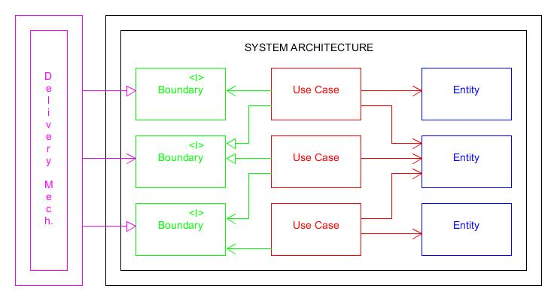
Architecture use cases and high level design
Notes:
These isolation makes it easier to write and run tests
Nicely organized architectures makes you go faster

Slide 54
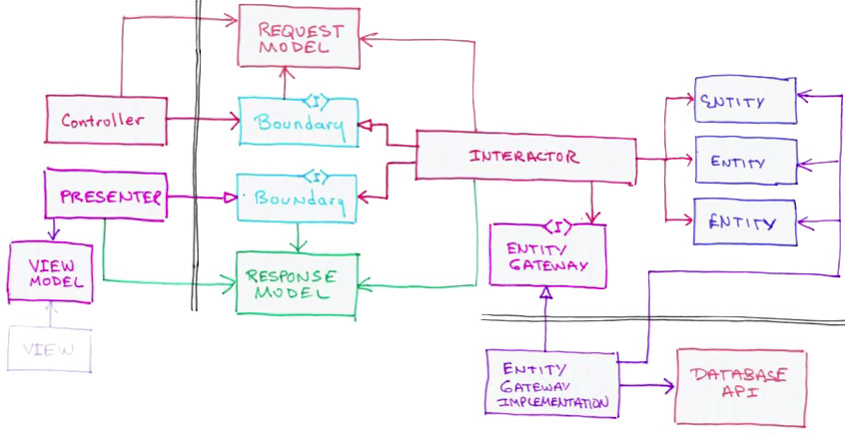
Architecture use cases and high level design
Notes:
Isolation
In the case of a Web app
- web server, css, html, javascript, MVC lives on the delivery side of the boundary
model on the boundary side? isn't that supposed to be on the other side? NO!!!
Yes because in now days the models from MVC is munch more complicated than a simple business object model
Boundary:
- 2 set of interfaces:
a) first set: used by the controller; implemented by the interactors, it accepts request model data structures
b) second set: used by the interactors, implemented by the presenters, it accepts response model data structures
Those interfaces are the boundary.

Slide 55
Architecture use cases and high level design
The Stakeholder Meeting
Some of our employees work hourly and they get paid in hourly rates and they have to submit time cards at the end of every day so on Fridays we need to know whether or not they worked 8 hour a days or 40 hours a week because if they did they get paid in the half. (get paid at the end of the week)
Some employees working sales and they get a commission rate plus the salary and every week they have to submit they sales receive on first of Friday they get paid but its a base rate plus their commission. (get paid biweekly)
Rest of the employees they are payed and on the last working day of the month then they just get their regular salary.
Employees to get paid by picking their pay at the paymaster, mailing it to them or depositing it to their account.
Some employee belongs to the union and the union deduces their dues out of their paychecks they have assess certain service charges from time to time, these charges are submitted to the payroll system at the end of the pay period and all be deducted out of the paychecks the next week.
This is a web based system and during the day our clerks will make changes to the database add employees, modifying existing employees, and add paychecks and delete old employees and sale receives and service charges. We want to be a web 2.0 system with a drag and drop feature and all that cool ajax stuff. We heard about ajax and we think that is really cool and think it will give us a competitive edge.
We think it should be a service oriented architecture we heard about SAVA and we really think it is the way to go. We also heard like that their is a standard database schema and a service protocol and a IPIAS standard. And we need to get done this by next month and we heard about the agile practices that make you go faster so we want you to use those. OK?
Notes:
(Optional)
NOTE:
Problem presentation (as complicated as possible)
Individual work for a basic diagram (entities + transaction boundaries) + some hints
15-20 time + break
Try to create a use case for adding new employees.
Try to create a diagram of the system’s architecture.
------------------------ Use case 1: A new employee is added by the receipt of an AddEmp transaction. This transaction contains the employee's name, address and assigned employee number. The transaction has three forms:
AddEmp <EmpID> "<name>" "<address>" H <hrly-rate> AddEmp <EmpID> "<name>" "<address>" S <mtly-rate> AddEmp <EmpID> "<name>" "<address>" C <mtly-rate> <com-rate> The eemployee record is created with its fields assigned appropriately.
Alternative 1: An error in the transaction If the transaction structure is inappropiate it is printed out in an error message, and no action is taken. -------------------------------------------------

Slide 56
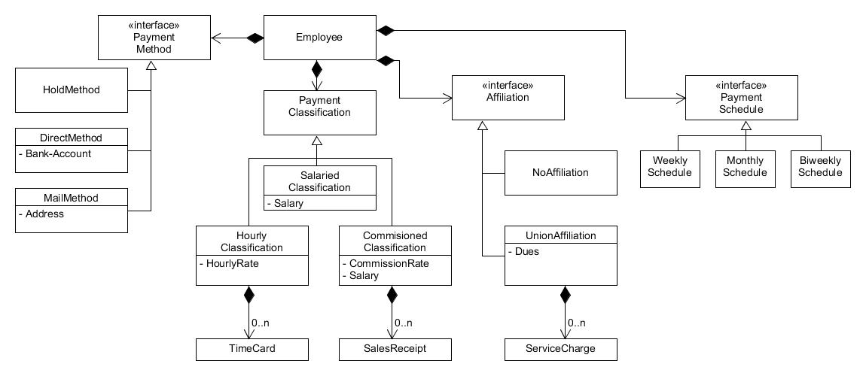
Architecture use cases and high level design
Notes:
(Optional)

Slide 57
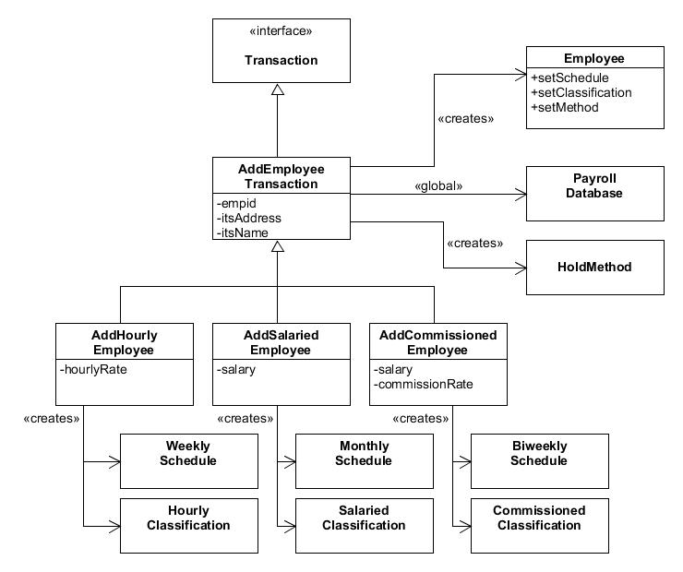
Architecture use cases and high level design
Notes:
(Optional)

Slide 58
SUMMARY
Explanatory naming's
Single responsibility small functions
Avoid using unnecessary comments
SOLID
Practice makes perfect!
Notes:
These are the most important things you need to remember

Slide 59
Useful books
Implementation patterns, Kent Beck
Refactoring Improving the design of existing code, Martin Fowler
The elements of programming style, Kernighan and Plauger
Writing effective use cases, Alistair Cockburn
User stories applied for agile software development, Mike Cohn
Object-Oriented software engineering, Ivar Jacobson
Agile Principles, Patterns, and Practices in C#; Robert C.Martin (for .NET guys)
Agile Software Development Principles, Patterns, and Practices; Robert C.Martin
Cheat sheet: Clean Code
Notes:
Cheat sheet for dotnet, but it contains links to similar content in a lot of other technologies too.

Slide 60
Notes:
Practice ideas:
https://github.com/emilybache/Tennis-Refactoring-Kata
https://github.com/emilybache/GildedRose-Refactoring-Kata

